Slide 1
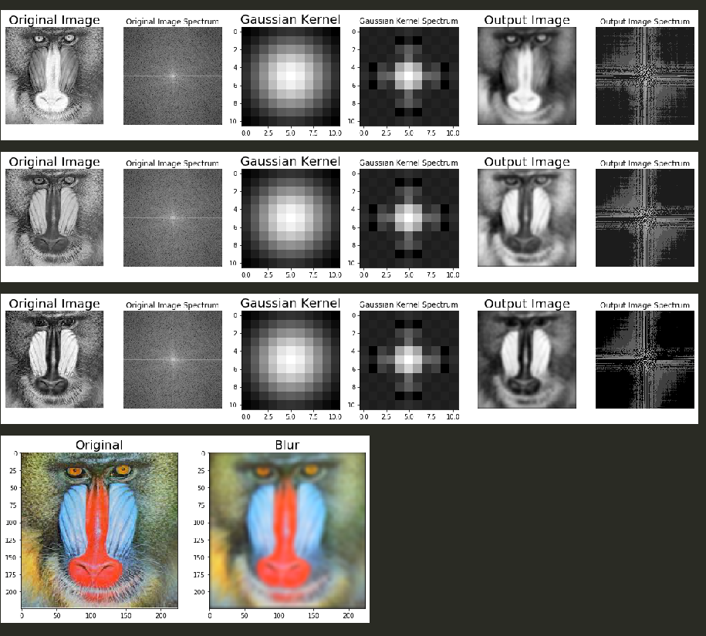
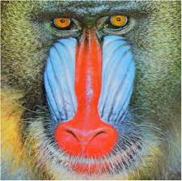
디지털영상처리 Homework #03
학번:
20193148
성명:
황진주
Scipy 패키지 fftconvolve() 함수를 사용하여 컬러 영상에 대한 가우시안 블러(gaussian blue) 과정을 구현하시오. (가정) 입력 영상은 mandrill.jpg로 한다. (가정) gaussian kernel 크기는 11, sigma 3 으로 한다
import cv2
import numpy.fft as fp
import numpy as np
from skimage.io import imread
import matplotlib.pylab as pylab
from scipy import signal
im = imread('./images/mandrill.jpg')
img_arr = cv2.split(im)
color_arr = []
# 가우시안 필터 처리 후 곱셈
for i in range(0,3) :
img_convert = np.clip(img_arr[i],0,255)
gauss_kernel = np.outer(signal.gaussian(11, 3),
signal.gaussian(11, 3))
# 원본이미지 fft
freq = fp.fft2(img_convert)
# 가우시안 커널 fft
freq_kernel = fp.fft2(fp.ifftshift(gauss_kernel))
# fp.ifftshift : 이미지를 중앙으로 보낸다.
# Scipy 패키지 fftconvolve() 컨볼루션 적용
convolved = signal.fftconvolve(img_convert, gauss_kernel, mode='same')
# .real 실수만 선택 복소수 제거를 위함
im1 = fp.ifft2(convolved).real
pylab.figure(figsize=(20,15))
pylab.subplot(1,6,1),
pylab.imshow(img_arr[i]), pylab.title('Original Image',size=20), pylab.axis('off')
pylab.subplot(1,6,3),
pylab.imshow(gauss_kernel), pylab.title('Gaussian Kernel', size=20)
pylab.subplot(1,6,5),
pylab.imshow(convolved) , pylab.title('Output Image', size=20), pylab.axis('off')
pylab.subplot(1,6,2),
pylab.imshow( (20*np.log10( 0.1 + fp.fftshift(freq))).astype(int)), pylab.title('Original Image Spectrum', size=12), pylab.axis('off')
pylab.subplot(1,6,4),
pylab.imshow( (20*np.log10( 0.1 + fp.fftshift(freq_kernel))).astype(int)), pylab.title('Gaussian Kernel Spectrum', size=12)
pylab.subplot(1,6,6)
pylab.imshow( (20*np.log10( 0.1 + fp.fftshift(fp.fft2(convolved).real)).astype(int)) ), pylab.title('Output Image Spectrum', size=12), pylab.axis('off')
pylab.subplots_adjust(wspace=0.2, hspace=0)
pylab.show()
color_arr.append( ( convolved ).astype(int) )
merge_img =cv2.merge([color_arr[0], color_arr[1], color_arr[2]])
# 값 비교용 : blur = cv2.GaussianBlur(im,(11,11),3)
merge_img = (merge_img / 45).astype(int)
pylab.figure(figsize=(10,5))
pylab.subplot(1,2,1), pylab.imshow(im)
pylab.title('Original', size=20)
pylab.subplot(1,2,2), pylab.imshow( np.clip(merge_img, 0, 255) )
pylab.title('Blur', size=20)

